Slide 1
Super Cut out
Created By Adam King

Slide 2
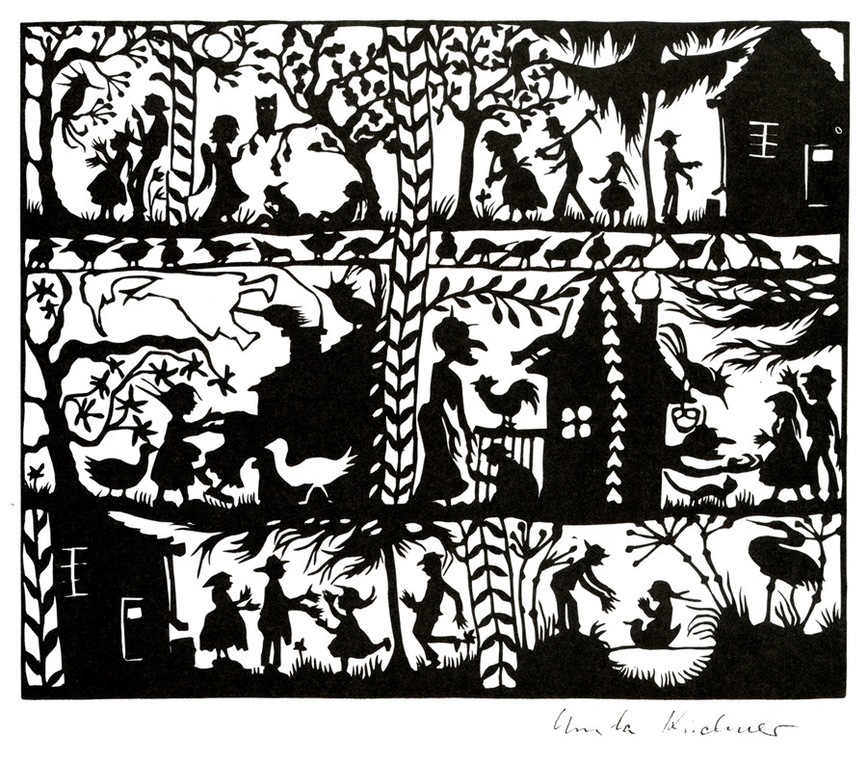
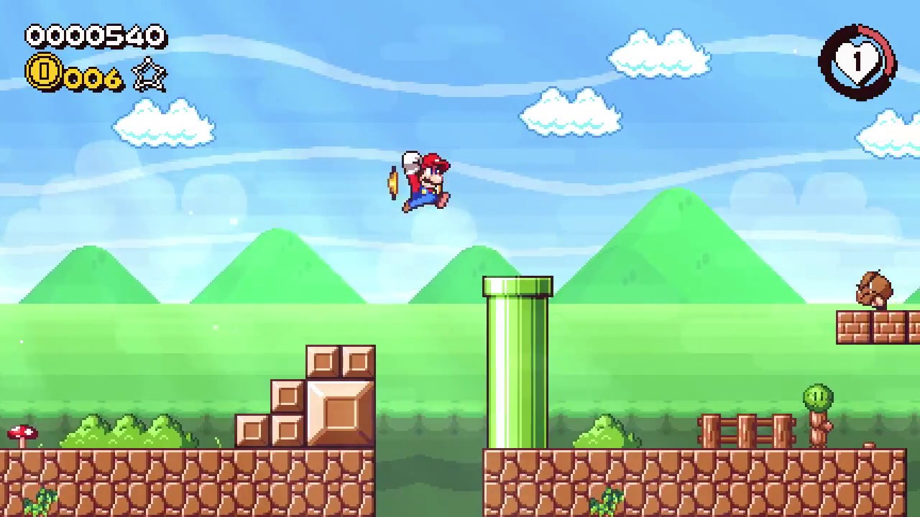
The Game idea?
I based my game idea around Mario kart theme and also the paper cut out theme. The paper cut out was my first main idea for the game and then it reminded me of Mario and that’s how the idea came together.

Slide 3

What do you do in the game?
In the game the idea is to jump onto platforms and collect bits of paper that are scattered over the game and get as many as you can, while being timed.
This is the paper icon you will be collecting around/during the game.

Slide 4

Who and how was created the game?
The creator for the game is me Adam King and I created the Game in a Programme call Unity and all the other 2D platforms/background and the character I created them in Photoshop.

Slide 5
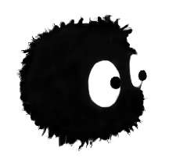
My Character

Slide 6
My survey
I’ve gone through my survey that I’ve and sent them to a group of peers.
I’ve taken notes and going to do some changes down the line of the game.

Slide 7
Survey Questions And Answers
Would you rather see the game keep going along or just go to new scene when completing the level?
Answers
Go to a new level.
Go to the next level when completing the first one.
When completing a level go to a new scene.
Would u see other colours?
Answers
No the colours are fine, it all goes with it.
Add different colours as you get higher in levels.
Yes.
Be good to see other colours.
Would you want to see a stat counter?
Answers
Yes .
Yes.
Yes it would be good to see how much paper we collect at the end.
Yes .
Do you want to see more platforms?
Answers
Add more platforms as you go higher in levels.
Yes more would be better.
Yes add more at every level.
There’s enough platforms for the first level but maybe add more the further you go.

